Slide 1
CEN 522:Microprocessor Systems and Interfacing
Basic Microprocessor System
BY OMORUYI O.

Slide 2
Topics (Module 1)
The CPU,
Memory subsystem
I/O subsystem
Buses subsystem

Slide 3
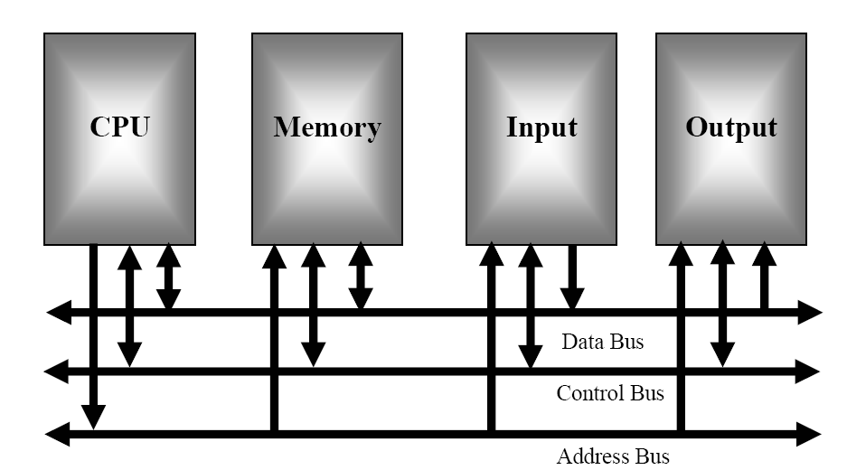
OVERVIEW OF MICROCOMPUTER STRUCTURE AND OPERATION (Von Neumann model of computer)

Slide 4
Von Neumann model of computer
The major parts of this model are the central processing unit (CPU), memory, and the Input and output circuitry or l/O.
The three buses are the address bus, the data bus, and the control bus.

Slide 5
Central Processing Unit
The central processing unit or CPU controls the operation of the computer. In a computer the CPU is a microprocessor. The CPU fetches binary-coded instructions from memory, decodes the instructions into a series of simple actions, and carries out these actions in a sequence of steps. The CPU also contains an address counter or instruction pointer register, which holds the address of the next instruction or data item to be fetched from memory; general-purpose registers, which are used for temporary storage of binary data; and circuitry, which generates the control bus signals.

Slide 6
MEMORY
The memory section usually consists of a mixture of RAM (Random Access Memory) and ROM (Read Only Memory). It may also have magnetic floppy disks, magnetic hard disks, or optical disks (CDs, DVDs). Memory has two purposes:
The first purpose is to store the binary codes for the sequences of instructions you want the computer to carry out. When you write a computer program, what you are really doing is writing a sequential list of instructions for the computer.
The second purpose of the memory is to store the binary-coded data with which the computer is going to be working. This data might be the inventory records of a supermarket, for example.

Slide 7
INPUT/OUTPUT
The input/output or I/O section allows the computer to take in data from the outside world. Peripherals such as keyboards, video display terminals, printers, and modems are connected to the I/O section. The actual physical devices used to interface the computer buses to external systems are often called ports. An input port allows data from a keyboard, an A/D converter, or some other source to be read into the computer under control of the CPU. An output port is used to send data from the computer to some peripheral, such as a video display terminal, a printer, or a D/A converter.

Slide 8
INPUT/OUTPUT (cont’d)
Physically, the simplest type of input or output port is just a set of parallel D flip-flops. If they are being used as an input port, the D inputs are connected to the external device, and the Q outputs are connected to the data bus which runs to the CPU. Data will then be transferred through the latches when they are enabled by a control signal from the CPU. In a system where they are being used as an output port, the D inputs of the latches are connected to the data bus, and the Q outputs are connected to some external device. Data sent out on the data bus by the CPU will be transferred to the external device when the latches are enabled by a control signal from the CPU.

Slide 9
Bus
When referring to a computer, the bus also known as the address bus, data bus, or local bus is a data connection between two or more devices connected together. e.g bus enables a computer processor to communicate with the memory or a video card to communicate with the memory.
A bus is capable of being (parallel or a serial bus), (Synchronized or Asynchronized)
Today all computers utilize two types of buses, an internal or local bus and an external bus.
An internal bus enables a communication between internal components such as a computer video card and memory (e.g. ISA, EISA, PCI, AGP, etc.)
External bus is capable of communicating with external components such as a SCSI bus.
A computer or devices bus speed or throughput is always measured in bits per second (bps), kilobits per second(kbps) or megabytes per second.
The bus is not only cable connection but also hardware (bus architecture), protocol, software, and bus controller

Slide 10
Bus (cont’d)
The computer bus connects all devices to the computer CPU and main memory. The computer bus consists of three parts the address bus, a data bus and control bus. The data bus transfers actual data whereas the address bus transfers information about where the data should go. The control bus exchanges all control signals. The following part contains a brief overview on each of the computer buses.

Slide 11
Data Bus
The data bus consists of 8, 16, or 32 parallel signal lines. As indicated by the double-ended arrows on the data bus line in Figure 1, the data bus lines are bidirectional. This means that the CPU can read data in from memory or from a port on these lines, or it can send data out to memory or to a port on these lines.
Many devices in a system will have their outputs connected to the data bus, but only one device at a time will have its outputs enabled.
Any device connected on the data bus must have three-state outputs so that its outputs can be disabled when it is not being used to put data on the bus.

Slide 12
Address Bus
The address bus consists of 16, 20, 24, or 32 parallel signal lines. On these lines the CPU sends out the address of the memory location that is to be written to or read from.
The number of memory locations that the CPU can address is determined by the number of address lines. If the CPU has N address lines, then it can directly address 2N memory locations. For example, a CPU with 16 address lines can address 216 or 65,536 memory locations, a CPU with 20 address lines can address 220 or 1,048,576 locations, and a CPU with 24 address lines can address 224 or 16,777,216 locations.
When the CPU reads data from or writes data to a port, it sends the port address out on the address bus.

Slide 13
Control Bus
The control bus consists of 4 to 10 parallel signal lines. The CPU sends out signals on the control bus to enable the outputs of addressed memory devices or port devices.
Typical control bus signals are Memory Read, Memory Write, I/O Read, and l/O Write.
To read a byte of data from a memory location, for example, the CPU sends out the memory address of the desired byte on the address bus and then sends out a Memory Read signal on the control bus. The Memory Read signal enables the addressed memory device to output a data word onto the data bus. The data word from memory travels along the data bus to the CPU.

Slide 14
Topics (Module 2)
Basic operation of a microprocessor system
Fetch and execute cycle
The architecture of some typical 8-bit, 16-bit microprocessors (INTEL, MOTOROLA) and their features.

Slide 15
Basic operation of a microprocessor system
A microprocessor system fetches each program instruction, decodes the instruction and executes it.
Using the example of a Bus Operation, the CPU in the microcomputer fetches instructions or reads data from memory by sending out an address on the address bus and a memory read signal on the control bus. The memory outputs, the addressed instruction or data word to the CPU on the bus.
The CPU writes a data word to memory by sending out an address on the address bus, sending out the data word on the data bus and sending a memory write signal to memory on the control bus.
To read from a port, CPU sends out the port address on the address bus and sends an I/O read signal to the port device on the control bus Data from the port comes into CPU on the data bus.
To write data to a port, the CPU sends out the port address on the address bus, sends out the data to be written to the port on the data bus, and sends an I/O write signal to the port device on the control bus.

Slide 16
Basic operation of a microprocessor system (Another way to look at it)
A microprocessor executes a collection of machine instructions that tell the processor what to do. Based on the instructions, a microprocessor does three basic things:
Using its ALU (Arithmetic/Logic Unit), a microprocessor can perform mathematical operations like addition, subtraction, multiplication and division. Modern microprocessors contain complete floating point processors that can perform extremely sophisticated operations on large floating point numbers.
A microprocessor can move data from one memory location to another.
A microprocessor can make decisions and jump to a new set of instructions based on those decisions.
There may be very sophisticated things that a microprocessor does, but those are its three basic activities. The following diagram shows an extremely simple microprocessor capable of doing those three things:

Slide 17
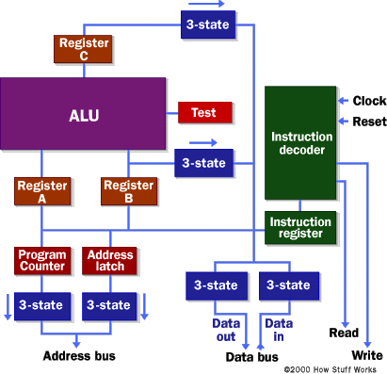
Basic operation of a microprocessor system (Another way to look at it) cont’d
an address bus (that may be 8, 16 or 32 bits wide) that sends an address to memory
a data bus (that may be 8, 16 or 32 bits wide) that can send data to memory or receive data from memory
a RD (Read) and WR (Write) line to tell the memory whether it wants to set or get the addressed location
a clock line that lets a clock pulse sequence the processor
A reset line that resets the program counter to zero (or whatever) and restarts execution.
See http://www.zenith-india.com/zen/TrainingMaterial/details/howmicroprocessorswork.htm

Slide 18
Fetch and execute cycle
To understand how the CPU operates, let’s look at how an instruction is executed. The machine instruction has two major parts: an opcode and operands.
The opcode specifies the type of operation and operands are often given as memory address to the data to be manipulated.
The two operation cycles of the microprocessor are: (Fetch - Execute cycle)

Slide 19
Fetch and execute cycle cont’d
Fetch:
1. Fetch an instruction from memory
2. Decode the instruction to determine the operation
3. Fetch data from memory if necessary.
Execute:
1. Perform the operation on the data
2. Store the result in memory if needed.

Slide 20
Microprocessor Architecture
Architecture:
The basic function of a µp is to fetch, decode and execute instructions held in ROM or RAM.
To accomplish this it must fetch data from an external memory source and transfer it into its own internal memory, each addressable component which is called a register.
It must also be able to distinguish between instructions and operands, that is, the. read/write memory locations containing the data to be operated on i.e. byte addressable location in ROM, RAM or in the µp’s own registers.
In addition, the µp must perform additional tasks such as responding to external events such as resets and interrupts, provide memory management facilities to the operating system, etc. A consideration of the fundamental components in a basic microprocessor is first undertaken before introducing more complex modern devices.

Slide 21
Microprocessor components or units
The Execution unit (EU)
The Bus interface unit (BIU)

Slide 22
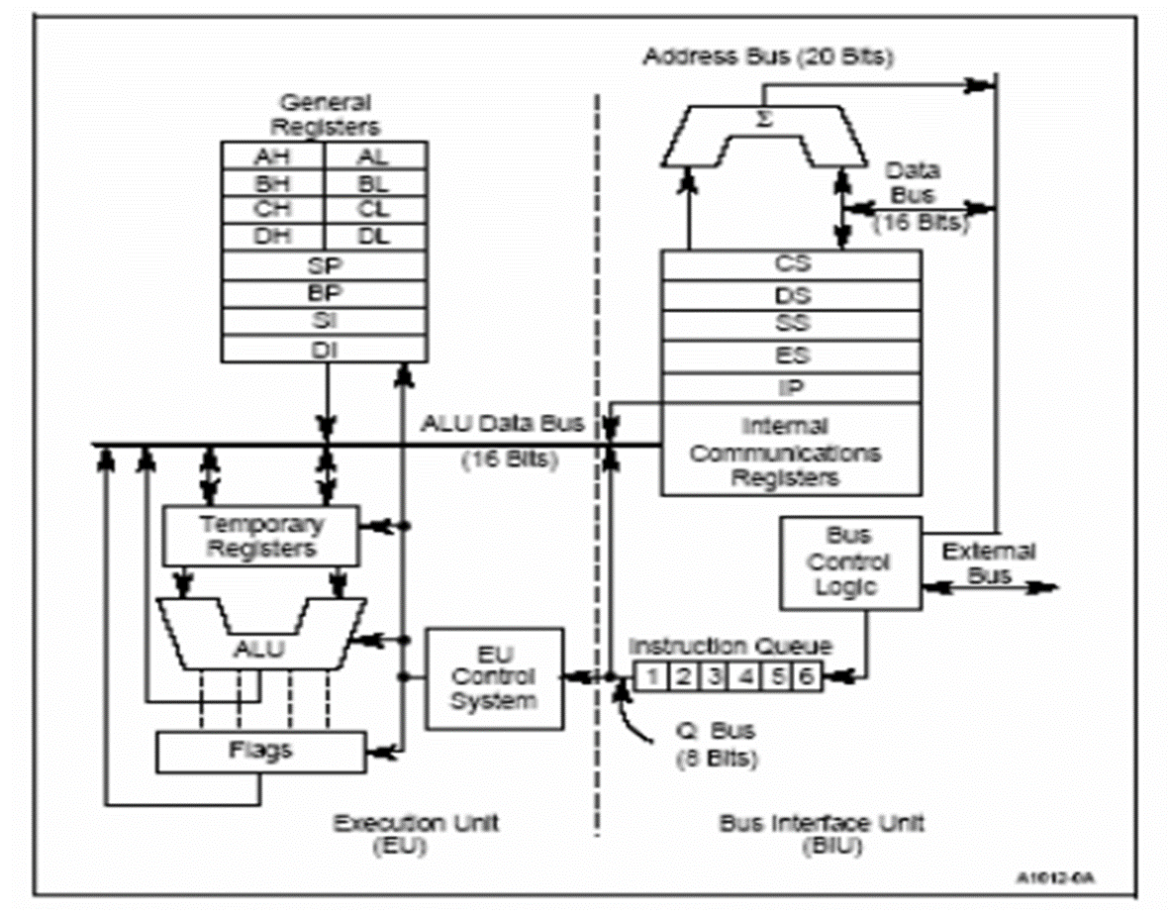
80C186 CPU family Architecture

Slide 23
Execution unit
The Execution Unit executes all instructions, provides data and addresses to the Bus Interface Unit and manipulates the general registers and the Processor Status Word. The 16-bit ALU within the Execution Unit maintains the µp status and control flags and manipulates the general registers and instruction operands. All registers and data paths in the Execution Unit are 16 bits wide for fast internal transfers.
The Execution Unit does not connect directly to the system bus. It obtains instructions from a queue maintained by the Bus Interface Unit. When an instruction requires access to memory or a peripheral device, the Execution Unit requests the Bus Interface Unit to read and write data. Addresses manipulated by the Execution Unit are 16 bits wide. The Bus Interface Unit, however, performs an address calculation that allows the Execution Unit to access the full megabyte of memory space.

Slide 24
Execution unit cont’d
To execute an instruction, the Execution Unit must first fetch the object code byte from the instruction queue and then execute the instruction. If the queue is empty when the Execution Unit is ready to fetch an instruction byte, the Execution Unit waits for the Bus Interface Unit to fetch the instruction byte.
(EU) is used mainly to execute instructions. It contains a circuit called the arithmetic and logic unit (ALU). The ALU performs arithmetic ( + , - , * , / ) and logic (AND,OR, NOT) operations. The data for operations are stored in circuit called Registers. A register is like a memory location except that we normally refer to it by a name rather than address.
The EU has eight registers for storing data; their names are AX, BX, CX, DX, SI, DI, BP, SP and FLAGS register.

Slide 25
Bus interface unit
The 80C186 family Bus Interface Units are functionally identical. They are implemented differently to match the structure and performance characteristics of their respective system buses. The Bus Interface Unit executes all external bus cycles. This unit consists of the segment registers, the Instruction Pointer, the instruction code queue and several miscellaneous registers. The Bus Interface Unit transfers data to and from the Execution Unit on the ALU data bus.

Slide 26
Bus interface unit functions
Facilitates communication between the EU and memory or I/O circuits.
It is responsible for transmitting address, data, and control signals on the buses.
Its registers are named CS, DS, ES, SS, IP; they hold addresses of memory locations.
Example: The IP contains the address of next instruction to be executed by the EU.

Slide 27
How they work?
The EU and the BIU are connected via an internal bus and they work together. While the EU is executing an instruction, the BIU fetches up to six bytes of the next instruction and places them in the instruction queue.
This operation is called Instruction pre-fetch. The purpose is to speed up the processor.

Slide 28
Registers
Registers are for a variety of purposes such as holding the address of instructions and data, storing the result of an operation, signalling the result of a logic operation, or indicating the status of the program or the µp itself. Some registers may be accessible to programmers, while others are reserved for us by the µp itself.
Registers store binary values such as 1 or 0 as electrical voltages of say 5 volts or 0 volts. They consist of several integrated transistors which are configured as a flip-flop circuits each of which can be switched into a 1 or 0 state.
The width of a register depends on the type of µp, e.g., an 16, 32 or 64 bit microprocessor. In order to provide backward compatibility, registers may be sub-divided. For example, the Pentium processor is a 32 bit CPU, and its registers are 32 bits wide. Some of these are sub-divided and named as 8 and 16 bit registers in order to run 8 and 16 bit applications designed for earlier x86 microprocessors.

Slide 29
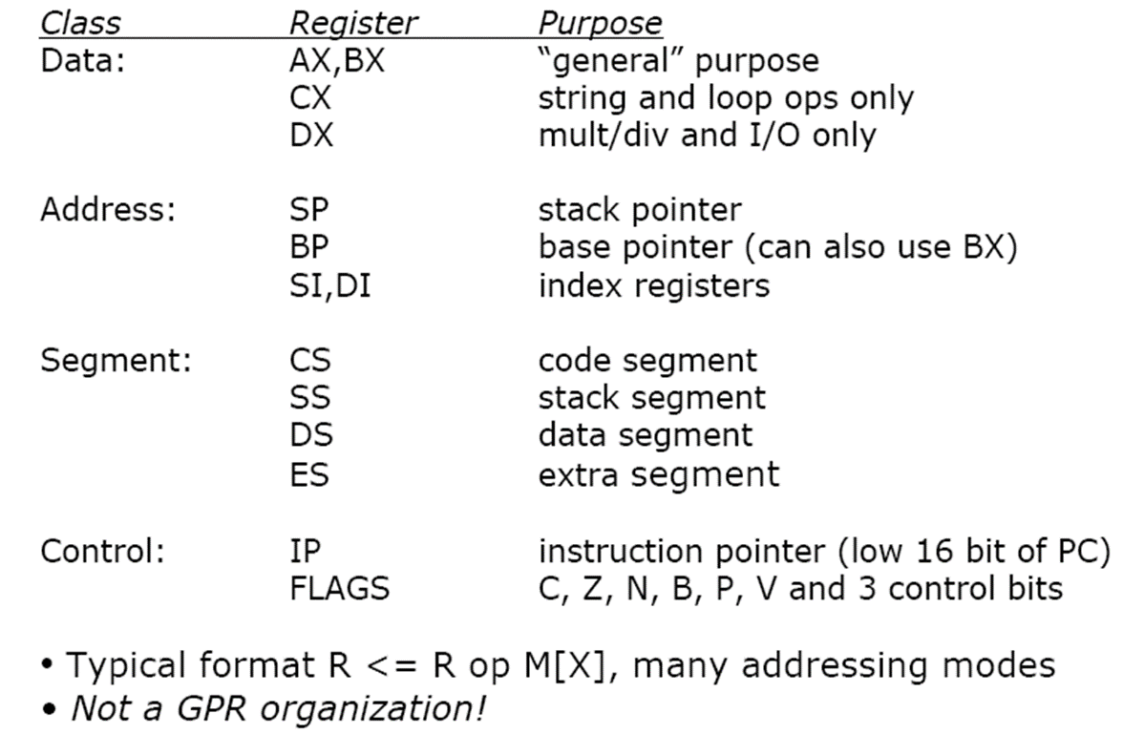
Intel 8086 Registers

Slide 30
Registers cont’d
Instruction Register: When the Bus Interface Unit receives an instruction it transfers it to the Instruction Register for temporary storage. In Pentium processors the Bus Interface Unit transfers instructions to the L1 I-Cache, there is no instruction register as such.
Stack pointer: A stack is a small area of reserved memory used to store the data in the µp’s registers when:
system calls are made by a process to operating system routines;
when hardware interrupts generated by input/output (I/O) transactions on peripheral devices;
when a process initiates an I/O transfer;
when a process rescheduling event occurs on foot of a hardware timer interrupt.

Slide 31
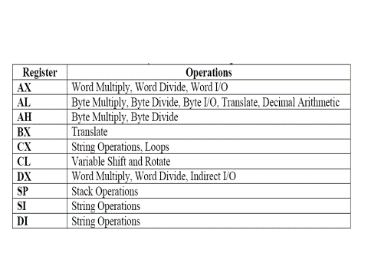
Some Registers and their uses

Slide 32
I/O Ports
I/O devices are connected to the computer through I/O circuits. Each of these circuits contains several register called I/O Ports. Some are used for data while others are used control commands. Like memory locations, the I/O ports have address and they are connected to the bus system. These addresses are known as I/O address and can only be use in input (IN) or output (OUT) instructions.

Slide 33
Serial and Parallel Interface
The data transfer between two digital systems can be achieved using single bit at a time (serial), or using 8bit, 16 bit, etc. at a time (parallel).
The parallel interface requires more wiring connections, while serial port tends to be slower.
Slow devices, like the keyboard, or remote interface like internet are always connected via serial interface;
Fast devices and directly interfaced devices like the disk drive, always connect via parallel port. But some devices like printers can be connected via either serial or parallel interface.

Slide 34
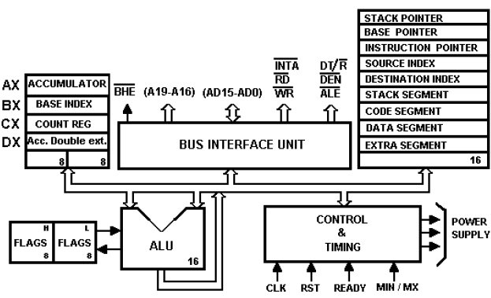
Intel 8086 Block diagram

Slide 35
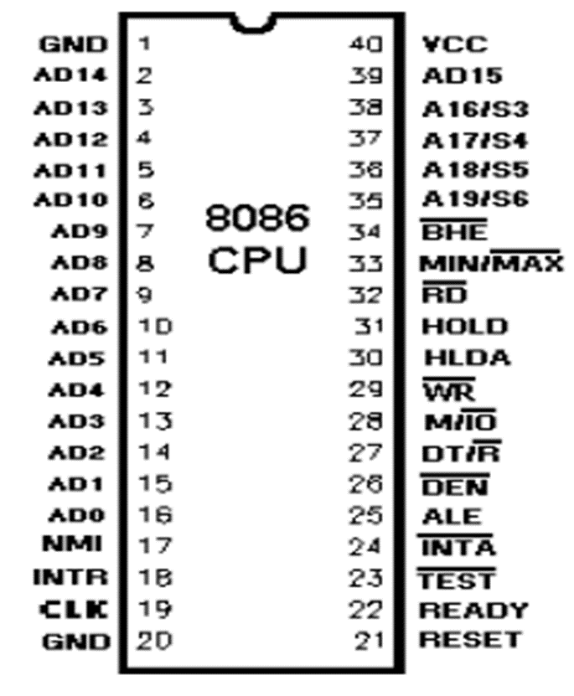
Intel 8086 Microprocessor Pin-out Minimum mode

Slide 36
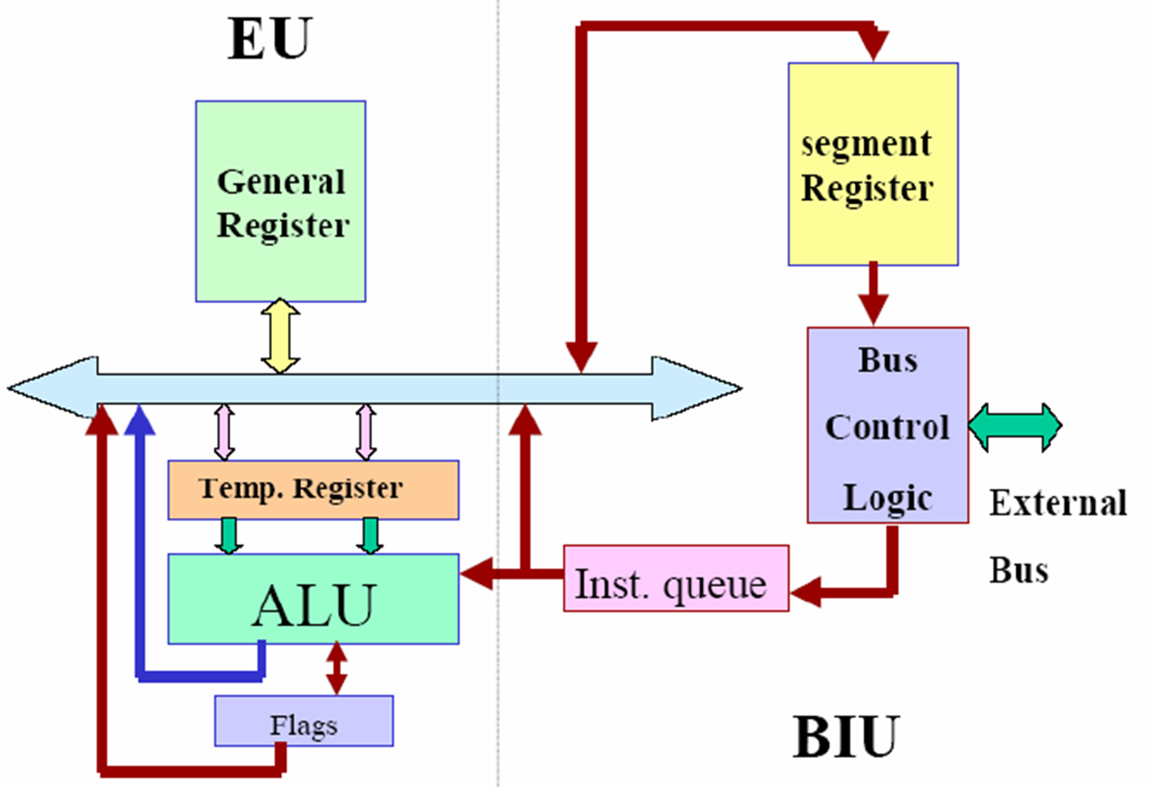
Intel 8086 Simplified structure

Slide 37
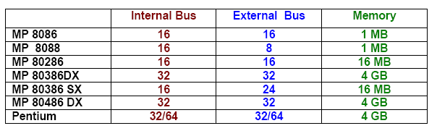
Intel Processor Family

Slide 38
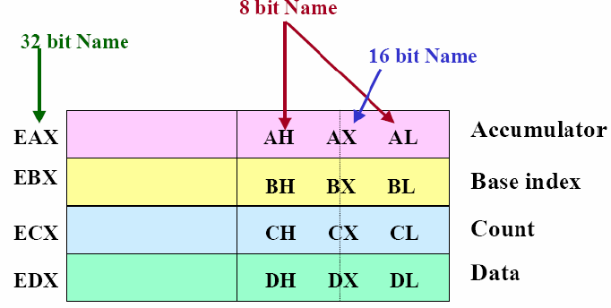
Intel Register Structure

Slide 39
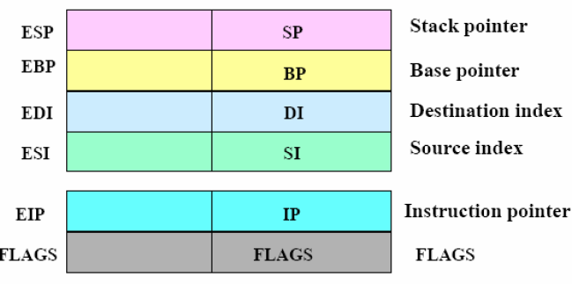
Intel 32 bit Register structure

Slide 40
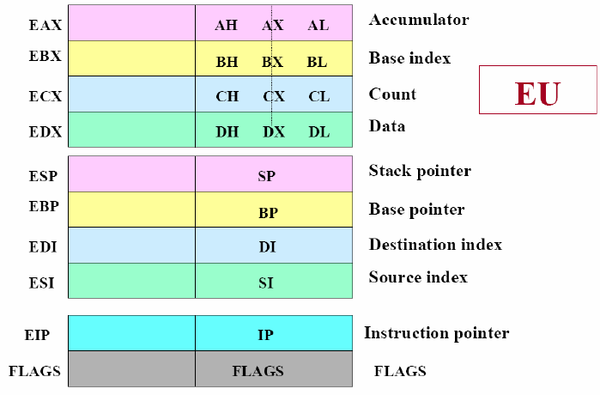
Intel EU Register Structure

Slide 41
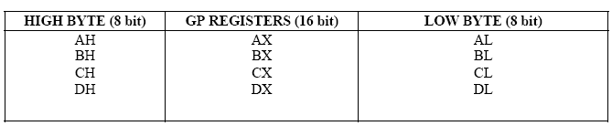
Intel General purpose registers

Slide 42
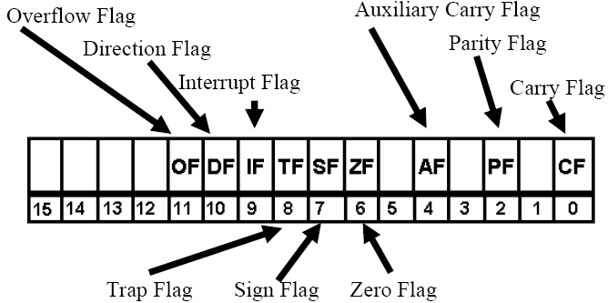
Intel 8086 Flag register

Slide 43
End of Module 2
Thank you!

